Slide 1
Digital Portfolio
STUDENT NAME: A.Anitha
REGISTER NO AND NMID: 24132231802522006
FF4106DA12FB0D49F7E4A84E900C5CF0DEPARTMENT: B.Sc Computer Science
COLLEGE: Dr.M.G.R Government Arts And Science College For Women ,Annamalai University

Slide 2
PROJECT TITLE
Digital Marketing Portfolio - Anitha.A

Slide 3


AGENDA
Problem Statement
Project Overview
End Users
Tools and Technologies
Portfolio design and Layout
Features and Functionality
Results and Screenshots
Conclusion
Github Link
3/21/2024 Annual Review

Slide 4

PROBLEM STATEMENT
Digital marketers often face challenges in presenting their work in an organized and impactful way. Traditional resumes and LinkedIn profiles are insufficient for demonstrating the full scope of digital marketing capabilities, such as SEO, social media campaigns, content marketing, and data analytics. There is a need for a centralized platform where professionals can:
Display their projects with detailed case studies.
Highlight measurable results and ROI.
Provide an easy way for potential clients or employers to contact them.
Ensure accessibility and responsiveness across all devices.

Slide 5

PROJECT OVERVIEW
This project is a responsive digital marketing portfolio website designed to showcase expertise and services. It effectively demonstrates skills in SEO, social media marketing, and content strategy through real-world case studies. The site features a modern, professional design that is optimized for all devices. It includes detailed service offerings, a portfolio of successful campaigns, and authentic client testimonials to build credibility. A functional contact form facilitates lead generation and client inquiries. The portfolio itself serves as a primary example of the creator's ability to drive online engagement and growth. It highlights measurable results and data-driven strategies to potential employers or clients. Ultimately, the website acts as a comprehensive personal branding and professional networking tool. This project successfully merges technical web development with strategic digital marketing principles.

Slide 6

WHO ARE THE END USERS?
Primary End Users:
Potential Employers - Hiring managers and agencies looking for digital marketing talent
Potential Clients - Businesses seeking digital marketing services
Academic Evaluators - Professors and college assessment committees
Secondary End Users:
Industry Peers - Other digital marketers for networking and collaboration
Students - Those learning about digital marketing portfolios
Indirect Users:
Website Visitors - Anyone interested in digital marketing strategies
Future Clients - Businesses that may need services later

Slide 7

TOOLS AND TECHNIQUES
Development Tools & Technologies:
HTML5 - For website structure and semantic markup
CSS3 - For styling, layout, and responsive design
JavaScript - For interactivity and dynamic elements
Font Awesome - For icons and visual elements
Google Fonts - For typography (Segoe UI font family)
Design Techniques:
Responsive Web Design - Media queries and flexible layouts
CSS Flexbox/Grid - For modern layout management
UI/UX Design Principles - User-centered design approach
Color Theory Application - Cohesive color scheme with primary/secondary colors
Visual Hierarchy - Strategic content organization

Slide 8
POTFOLIO DESIGN AND LAYOUT
Design Philosophy:
Clean, modern aesthetic with professional presentation
User-centered design focusing on intuitive navigation
Visual hierarchy that guides visitors through key content
Mobile-first responsive design approach
Layout Structure:
Header/Navigation: Fixed position with logo and menu items
Hero Section: Bold introduction with value proposition
Services Overview: Grid layout showcasing marketing specialties
Portfolio Showcase: Card-based design with project case studies
8

Slide 9
5.Testimonials: Social proof section with client feedback
6.Contact Section: Clean form with multiple contact options
7.Footer: Additional navigation and copyright information
Visual Design Elements:
Color Scheme: Professional blue and purple palette (#4a6cf7, #6f42c1)
Typography: Clean, readable Segoe UI font family
Imagery: High-quality, relevant marketing visuals
Icons: Font Awesome icons for visual interest
White Space: Ample spacing for content breathing room

Slide 10
FEATURES AND FUNCTIONALITY
Core Features:
Responsive design optimized for all devices (desktop, tablet, mobile)
Professional service showcase with detailed marketing specialties
Interactive portfolio section with case studies and measurable results
Client testimonial carousel for social proof and credibility
Contact form with validation for lead generation
Functional Components:
Smooth navigation with fixed header for easy browsing
Animated elements and transitions for enhanced user engagement
SEO-optimized structure with proper semantic markup
Social media integration and sharing capabilities
Fast loading times with optimized images and assets

Slide 11
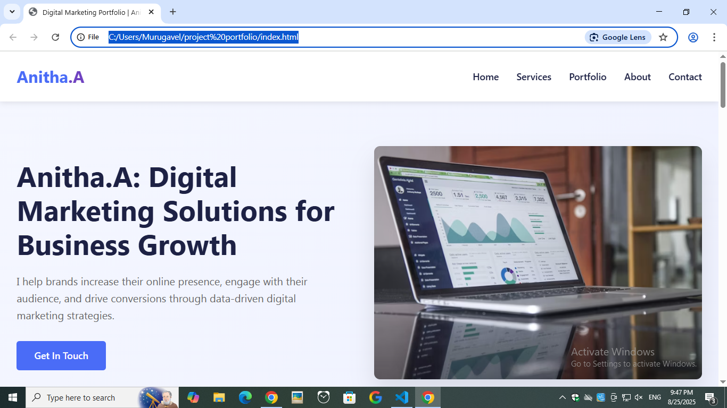

RESULTS AND SCREENSHOTS
3/21/2024 Annual Review
11

Slide 12
CONCLUSION
In conclusion, this project successfully resulted in the development of a comprehensive and professional digital marketing portfolio website. It effectively serves its dual purpose as both a functional academic submission and a practical tool for professional advancement. The portfolio adeptly showcases a wide range of digital marketing skills, from SEO and social media strategy to content creation and data analytics, through real-world case studies and measurable results. By implementing a responsive, user-centric design and integrating key functionalities like a contact form and testimonial section, the project demonstrates a strong understanding of modern web development principles and strategic marketing presentation. This portfolio establishes a powerful online presence, providing a solid foundation for attracting potential clients and employers while offering a scalable platform for future enhancements and continued professional growth.
12

